Slide 1
ATM INTERFACE
Name: Samiksha Harish Chaudhari
Batch : 2022-6520
Center : Pune
Technical Trainer : Chittaranjan Ghosh.

Slide 2
Introduction:
Automated Teller Machine enables the clients of a bank to have access to their account without going to the bank. This is achieved only by development the application using online concepts.When the product is implemented, the user who uses this product will be able to see all the information and services provided by the ATM, when he enters the necessary option and arguments. The product also provides services like request for withdrow, deposit cash and other advanced requirement of the user.
Modules:
Deposite Module
Withdrwal Module
Check Balance

Slide 3
Objective:
The main objective of the ATM Interface System is to reduce manual work and time. Now a days every one very busy in their work. So they feel that the job must be easier so the system is used to reduce their work which is done in the ATM system. Instead of keeping lots of paper into a record or file and it may be missed somewhere so, this system help to keep the record of the customer it also keeps the details of he customer. It is also easy to access.The propose the system customer transactions, satisfies the requirements of the existing system in full-fledged manner. Through this system, customer can make fast transactions and view the last transactions easily.

Slide 4
Software Requirements:
Front end: Java/J2EE technologies
Browser: Best result on Google Chrome
Operating System: Window

Slide 5
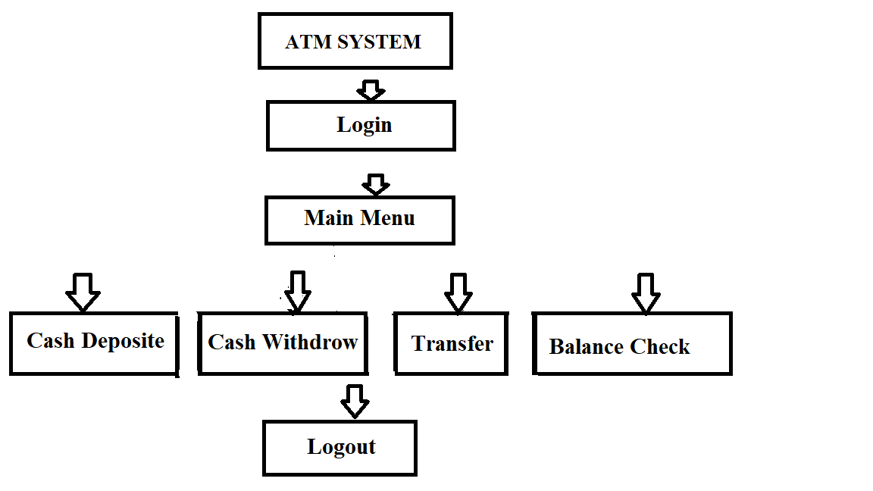
Architecture ATM System:

Slide 6
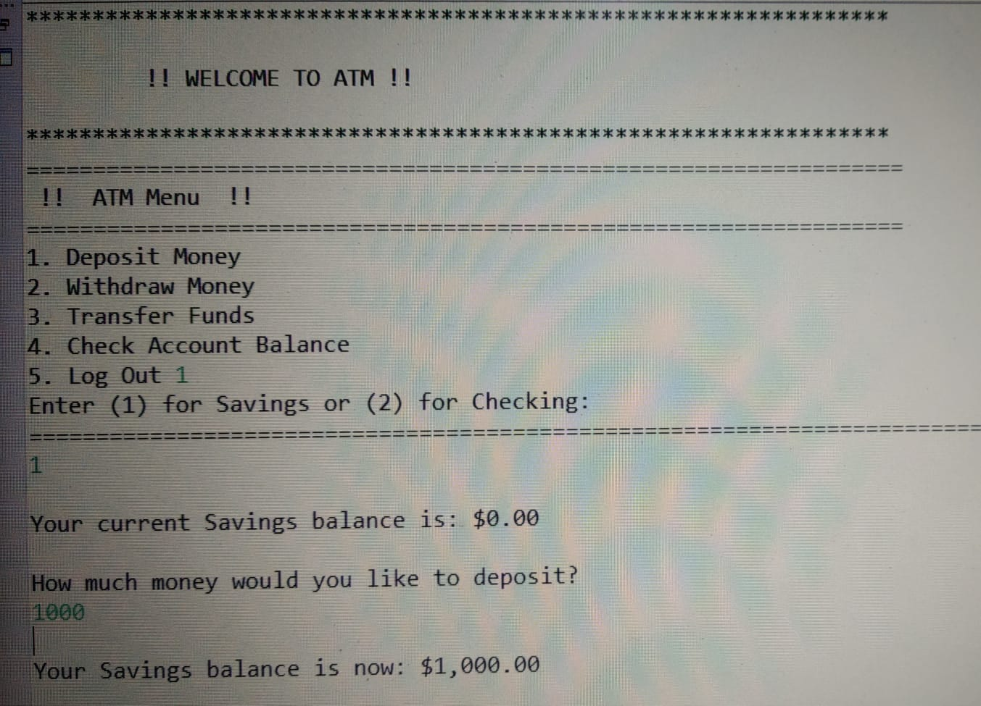
Result: 1)Deposite Cash

Slide 7
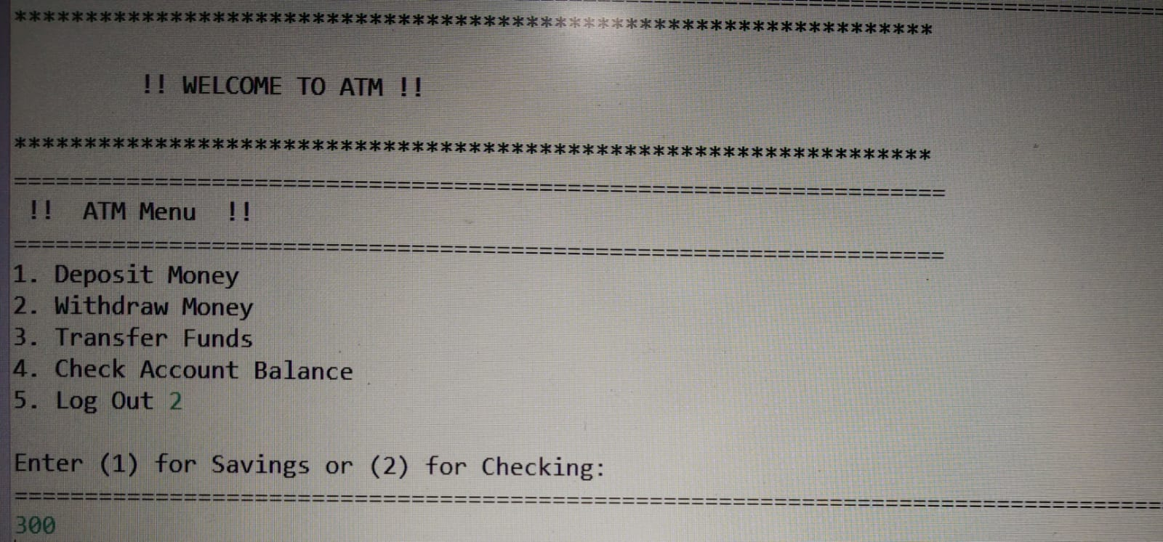
2) Withdrow Cash :

Slide 8
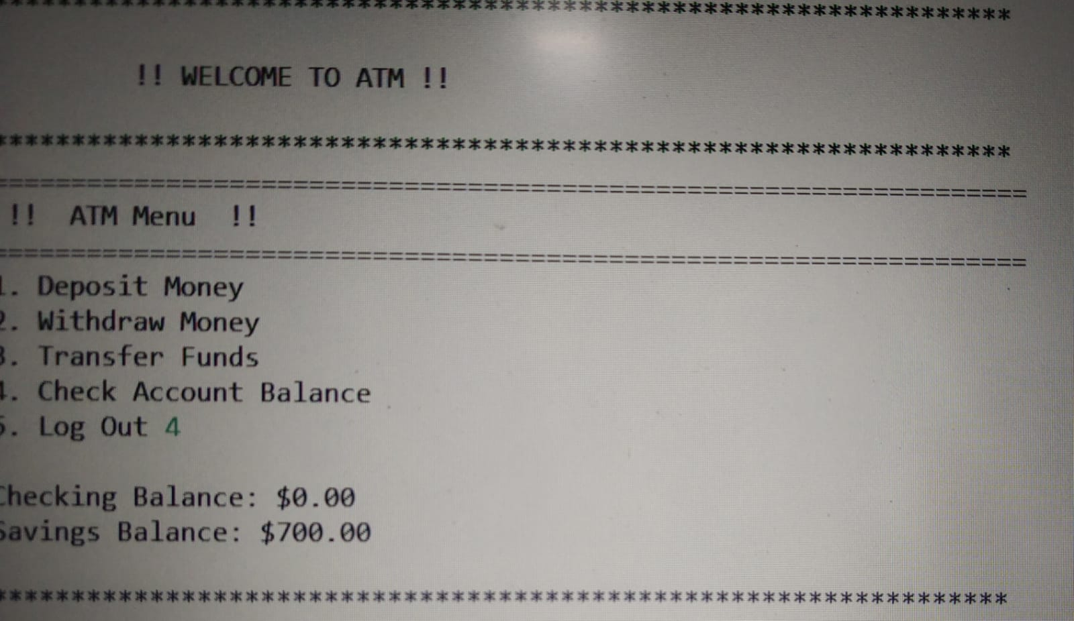
3)Balance Check:

Slide 9
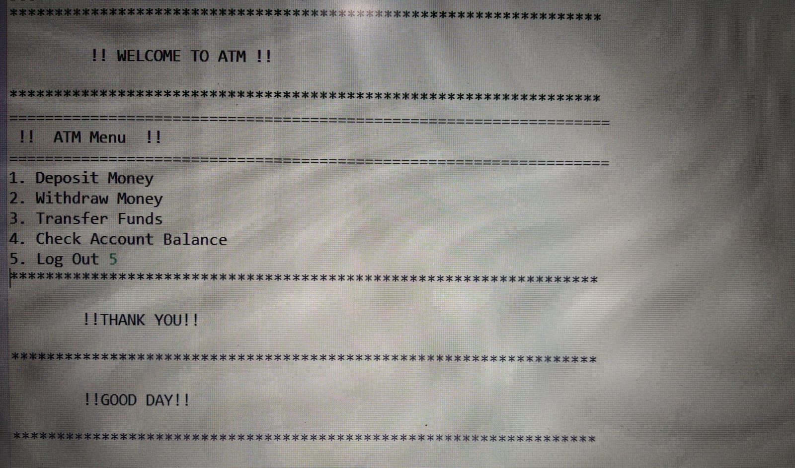
4) Logout:

Slide 10
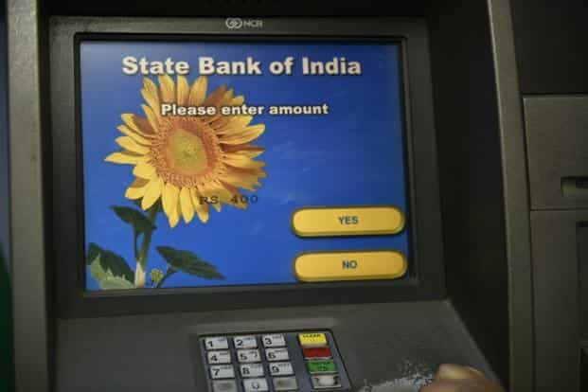
Thank You

